Slide 1
Usability Testing

Slide 2
Acknowledgements
Many Slides for this course from:
  Scott Klemmor hci-class.org
  Designing the User Interface: Strategies for Effective Human-Computer Interaction 5th edition by Ben Shneiderman and Catherine Plaisant.
  Human-Computer Interaction 3rd edition by Alan Dix, Janet Finlay, Gregory D. Abowd, Russel Beale.
  Design of Everyday Things by Don Norman
  Various other articles and my own thoughts

Slide 3
Storyboard Poll

Slide 4
What is Usability Testing
Evaluating a product or service by testing it with representative users
Usability testing will tell us:
  Whether a user can use a product as intended
  Whether a product allows a user to reach their goals
  How a user uses a product (not how we think a user should use a product)
  Where bugs and complicated user experiences lie within a product

Slide 5
Evaluating Design Through User Participation
You don’t know how good a user interface is until you try it out on people.
  Can people figure it out?
  If we change the design how will the user’s behavior change?
Designers think differently than users, test on users!

Slide 6
Example of Designers vs. Users
Amazon – added coupon code and lost money
Why?
Having that feature causes people to go online and search for coupon codes and many don’t come back.

Slide 7
User’s experience
Is the interface usable?
Is the user satisfied?
Is the user’s experience pleasant?
Is the user happy/frustrated/angry when using the interface?

Slide 8
Usability Testing Explained
Popular UX research methodology
A researcher asks a participant to perform tasks on an interface
Participant completes each task while the researcher observes
(usability testing is often interchangeable with user testing)
nngroup.com

Slide 9
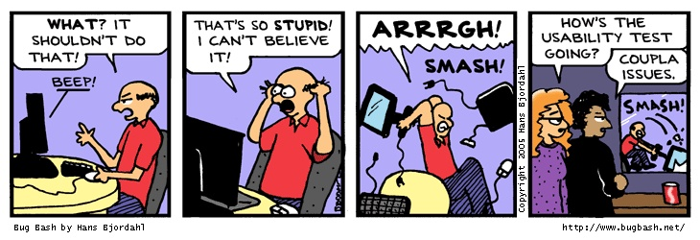
Usability Testing, cont.
In a usability test, representative users try to do typical tasks with the product, while the development staff watch, listen, and take notes.

Slide 10
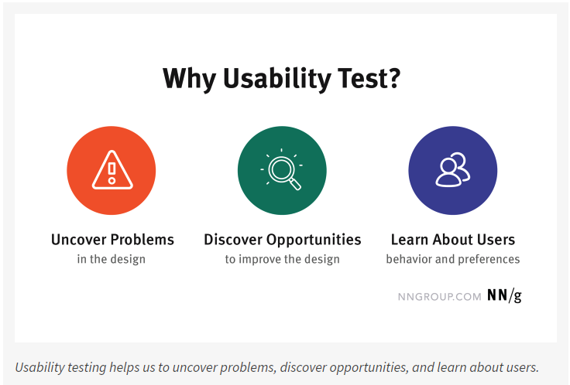
Why Do Usability Testing?
Identify usability problems in the product
nngroup.com

Slide 11
Why Do Usability Testing, cont.
Even the best UX designers can’t design a perfect user experience without iterative design driven by observations of real users and of their interactions with the design.
nngroup.com

Slide 12
Introduction
Hi there, I’m ____, a user researcher at _______. Thank you so much for talking with me today. I am really excited to have a conversation with you!
During this session, we are looking to better understand …
This session should take about ___ minutes.

Slide 13
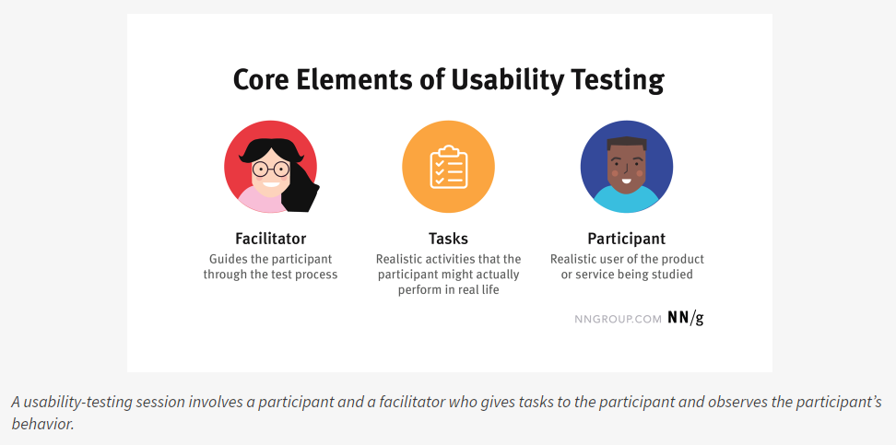
Usability Testing Elements
nngroup.com

Slide 14
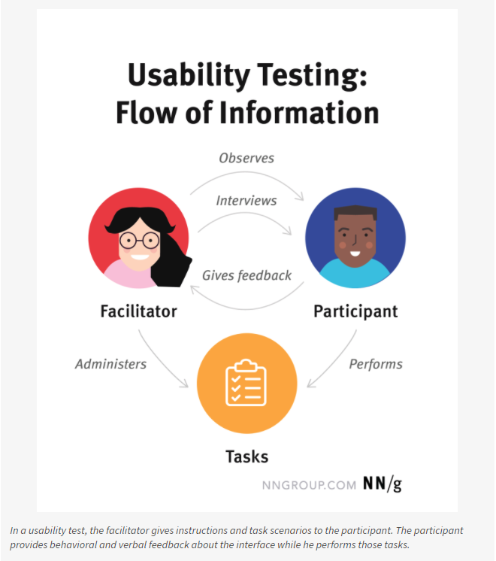
Flow
nngroup.com

Slide 15
Tasks
Ask a user to complete an action on your product.
Think about the most important tasks:
  What are the necessary actions every user must be able to accomplish on this app/website/product?
  What are the main goals of most of the users visiting this app/website/product?
  What tasks do they need to do to accomplish those goals?
  What are their motivations for visiting an app/website?
Dscout: Train your team

Slide 16
Tasks, cont.
Realistic Activities
Examples:
  You're considering opening a new credit card with Wells Fargo. Please visit wellsfargo.com and decide which credit card you might want to open, if any.
  You’ve been told you need to speak to Tyler Smith from the Project Management department. Use the intranet to find out where they are located. Tell the researcher your answer.
nngroup.com

Slide 17
Good vs Bad Tasks
Make Task Realistic:
  Poor task: Purchase a pair of orange Nike running shoes.
  Better task: Buy a pair of shoes for less than $40.
Make Task Actionable:
  Poor task: You want to see a movie Sunday afternoon. Go to www.fandango.com and tell me where you’d click next.
  Better task: Use www.fandago.com to find a movie you’d be interested in seeing on Sunday afternoon.
Nielsen Norman Group

Slide 18
Good vs Bad Tasks, cont.
Avoid Clues:
  Poor task: You want to see the results of your midterm exams. Go to the website, sign in, and tell me where you would click to get your transcript.
  Better task: Look up the results of your midterm exams.
Though Be Specific
  Poor task: Make an appointment with your dentist.
  Better task: Make an appointment for next Tuesday at 10am with your dentist, Dr. Petersen.
Nielsen Norman Group

Slide 19
Capturing results of User Evaluation
Option for capturing results
  Notebook to write things down.
  May record video which can help.
  Screen recording if want to capture what they did to user interface.
  Will you interrupt the user to see what they’re thinking or ask them to think out loud?

Slide 20
Thinking Aloud Method
Users say what they are thinking, feeling, doing as they go about their task.
Observer objectively takes notes on everything user says.
Often sessions use audio or video.
May need to prompt them to remind them to keep talking.

Slide 21
Qualitative vs. Quantitative
Qualitative usability testing -collecting insights about how people use the product. Best for discovering problems in the user experience. More common than quantitative.
Quantitative usability testing - focuses on collecting metrics that describe the user experience. Example: task success and time on task.
nngroup.com

Slide 22
Quantitative vs. Qualitative
Quantitative methods are helpful when evaluating the usability of a site.
Qualitative data can tell you what the problems are that users encountered.
Qualitative methods can be used to supplement quantitative ones.

Slide 23
Quantitative Example: System Usability Scale (SUS)
I think that I would like to use this system frequently.
I found the system unnecessarily complex.
I thought the system was easy to use.
I think that I would need the support of a technical person to be able to use this system.
I found the various functions in this system were well integrated.
I thought there was too much inconsistency in this system.
I would imagine that most people would learn to use this system very quickly.
I found the system very cumbersome to use.
I felt very confident using the system.
I needed to learn a lot of things before I could get going with this system.

Slide 24
Qualitative Examples
Observations
Open ended questions

Slide 25
Usability Testing Examples
My research examples
  Legal Analytics Website
    “Conduct a search for all judges with Kennelly in their name. How many results appear?”
    “What is the average case duration?”
  Cancer Survivors with Disabilities Mobile Health Prototype:
    “Go to the Course and click on the WeCanRelate session. Read through all of the cards.”
    “Find the Connect to Peers (C2P) option and filter to narrow the search to people who are deaf or hard of hearing.”
We also used SUS with open-ended questions after.

Slide 26
Usability Testing Examples, cont.
Any examples you all have?

Slide 27
What is a Controlled Experiment
Controlled experiments are quantitative and require a larger number of participants.
It usually compares the results from an experimental sample against a control group.
The control sample is practically identical to the experimental sample with one aspect that is being tested. (Old version of interface vs. Newer one)

Slide 28
User Testing vs. Controlled experiment
Usability Test:
  Single UI, early in design process
  Helps guide design
  Often qualitative feedback from users
  Few subjects
  Identify usability problems
Controlled Experiment
  Compare multiple UIs
  Measure final result / assessment
  Many subjects, strict protocol
  Quantitative results, statistical significance

Slide 29
Controlled Experiment Examples
Any examples you all have?

Slide 30
Usability Testing Poll
Which is something you would discover during Usability Testing?

Slide 31
Usability Testing Class Exercise
In Groups of about 3-4:
Improve the below task.
Add other tasks you think would be helpful for usability testing
  Poor task: You want to travel to a conference. Go to www.travelocity.com and show me what you would do next.
  Better task: _________

