Slide 1
Visual Design

Slide 2
Acknowledgements
Many Slides for this course from:
  Scott Klemmor hci-class.org
  Designing the User Interface: Strategies for Effective Human-Computer Interaction 5th edition by Ben Shneiderman and Catherine Plaisant.
  Human-Computer Interaction 3rd edition by Alan Dix, Janet Finlay, Gregory D. Abowd, Russel Beale.
  Design of Everyday Things by Don Norman
  Various other articles and my own thoughts

Slide 3
HCI
The Human – user – Focus on People
Computer – machine that runs the system
Interaction – interface
“Human–computer interaction (HCI) involves the study, planning, design and uses of the interfaces between people and computers.”
-Wikipedia

Slide 4
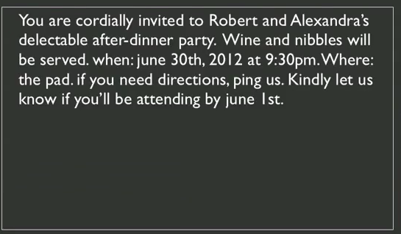
How would you improve this?
  *from Scott Klemmor

Slide 5
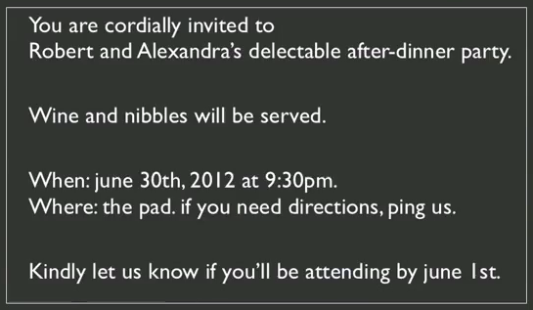
Introduce Whitespace
  *from Scott Klemmor

Slide 6
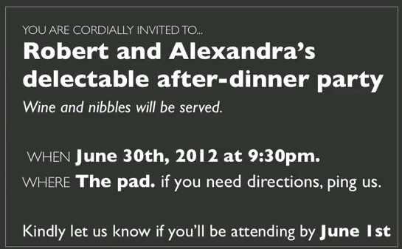
Size Contrasts
  *from Scott Klemmor
Notes:
Jennifer Tidwell Designing Interfaces

Slide 7
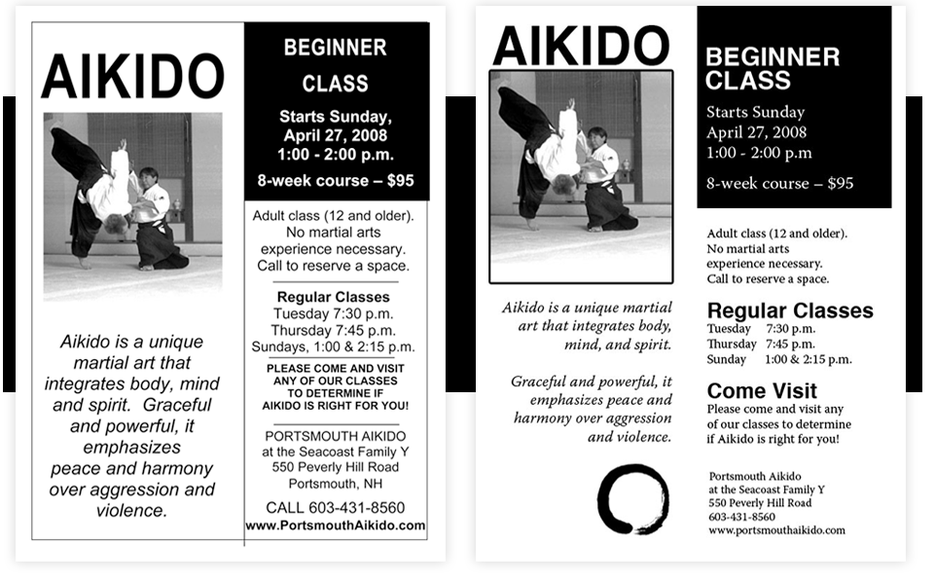
Which is nicer?
visualmess.com
Notes:
“If the one on the right looks cleaner to you, then – hooray! I've done my job”

Slide 8
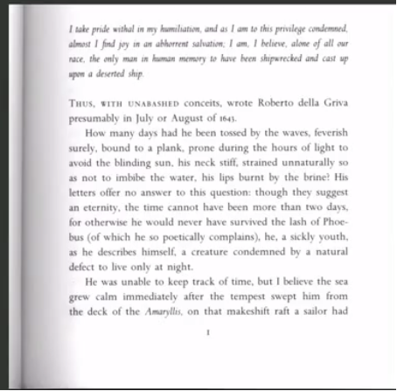
Book example
Quote first in italics which stands out.
Smallcaps used to begin each chapter. Good space above it.
Lots of whitespace all around which is important. Easier to read books with room around it.
Hard cover have more whitespace than cheaper paper back.
  *from Scott Klemmor

Slide 9
Goals for Visual Design
Convey structure
Draw people in, provide hooks

Slide 10
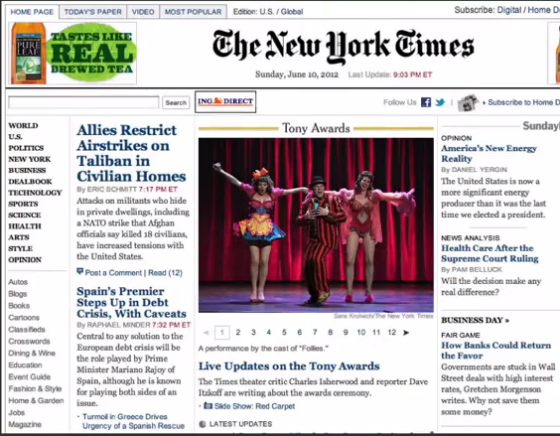
Example: New York Times
Hierarchy clear – header, image to draw you in.
Navigation on left and top.
  *from Scott Klemmor

Slide 11
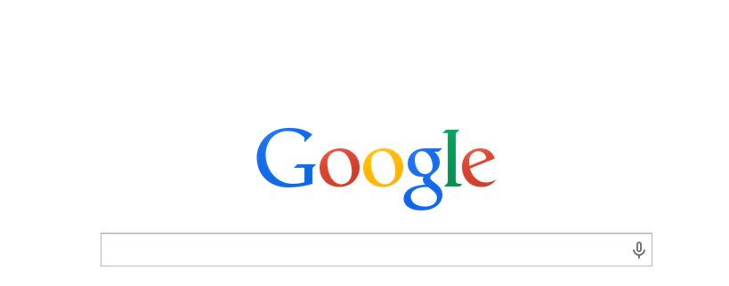
Another Example: Google
Search- know what to do when go there.
Logo reads loud and clear.
Google page is famous for its minimalism
  *from Scott Klemmor

Slide 12
Visual Tools
3 basic visual tools for organization and hierarchy:
Typography
Layout
Color
  *from Scott Klemmor

Slide 13
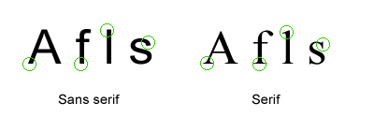
Typographic Terms: Sans Serif vs. Serif
HCI
HCI
Many say
Texts:
Serif – body in text (easier to read)
Sans Serif – use for Headers
Online:
Some say that sans serif can be easier to read on the web.
Not bad advice, but reading is also familiarity – if read with one style may be faster with that style.
In practice – it’s what you’re accustomed to.

Slide 14
What does this say?
  *from Scott Klemmor

Slide 15

What does this say? Cont.
  *from Scott Klemmor

Slide 16
Answers
The second one was harder:
I am a jelly donut
jfk spoke in berlin
More information coded in top half than bottom half of text.

Slide 17

What does this say now?
  *from Scott Klemmor

Slide 18
Answer
More people would say THE CAT rather than TAE CHT
Expectation plays an important role.

Slide 19

Another Example
What is this?
Ambiguous?
  *Human-Computer Interaction 3rd edition by Alan Dix, Janet Finlay, Gregory D. Abowd, Russel Beale.
Notes:
Dix book

Slide 20
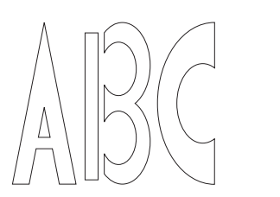
Context helps
  *Human-Computer Interaction 3rd edition by Alan Dix, Janet Finlay, Gregory D. Abowd, Russel Beale.
Notes:
Dix book

Slide 21
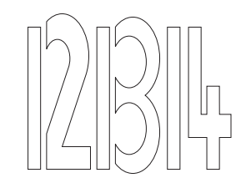
Context Helps: Our expectations help to disambiguate
  *Human-Computer Interaction 3rd edition by Alan Dix, Janet Finlay, Gregory D. Abowd, Russel Beale.
Notes:
Dix book

Slide 22
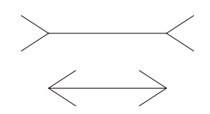
Which line is longer?
  *Human-Computer Interaction 3rd edition by Alan Dix, Janet Finlay, Gregory D. Abowd, Russel Beale.
Notes:
Dix book

Slide 23
Expectations
Our Expectations can also create optical illusions.

Slide 24
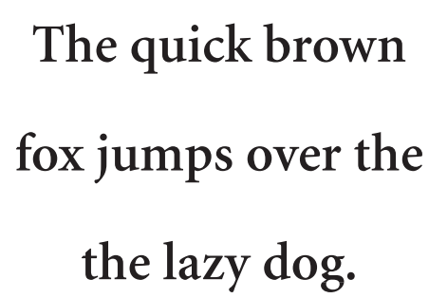
Another Example of expectations
Read the below:
  *Human-Computer Interaction 3rd edition by Alan Dix, Janet Finlay, Gregory D. Abowd, Russel Beale.
Notes:
Dix book

Slide 25
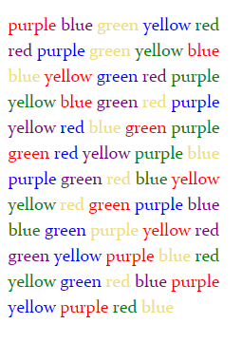
Expectations and Meanings
When you're creating a document, you want to eliminate conflicts between automatically perceived meaning and actual meaning.
Try saying the below colors.
visualmess.com
Notes:
Example first word you would say red

Slide 26
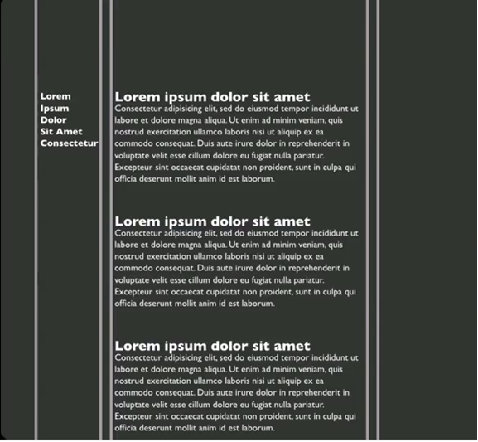
Layout: Grids
Grid – perhaps a narrow
left side is for
navigation and
wide main section
for body/content
  *from Scott Klemmor

Slide 27
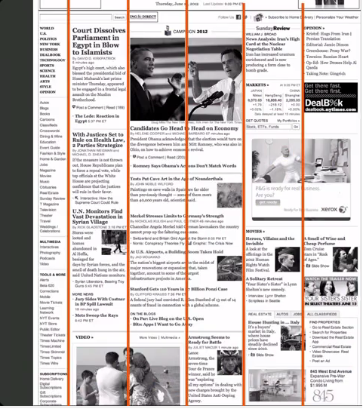
Grids, cont.
Newspapers, books,
and the Web use grids.
NYTimes – 5 column
for content with 6th for
navigation.
Some are 2 columns
wide to make it
dynamic.
  *from Scott Klemmor

Slide 28
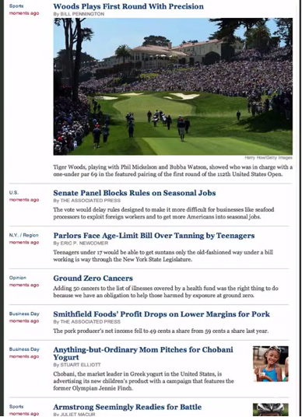
Context-View
Context view - Most recent
article on top and bigger.
  *from Scott Klemmor

Slide 29
Alignment
Alignment styles:
  Left-alignment is faster for skimming.
  If centered – a little slower since not aligned.
  right-aligned – can be clearer in cases (ex. form)
Use scale – important parts put bigger, less important smaller – so people know what’s more and less important in a page.

Slide 30
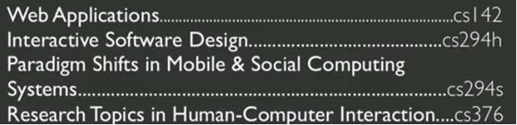
Table of Contents
Let’s improve this:
  *from Scott Klemmor

Slide 31
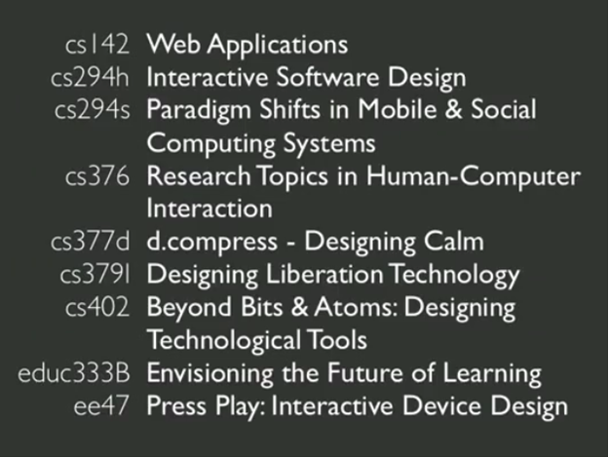
Table of Contents, cont.
Can make whichever side you want stand out:
Left-aligned
Right-aligned
Size contrasts
  *from Scott Klemmor

Slide 32
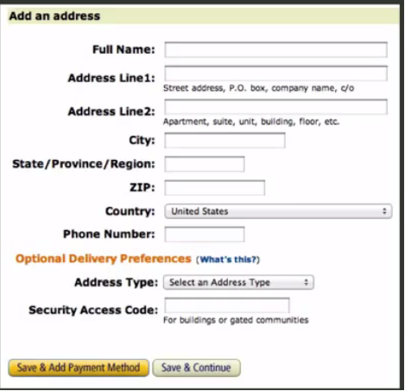
Amazon: Right-Alignment
Very clear on what to fill out.
right-aligned
left-aligned
  *from Scott Klemmor

Slide 33
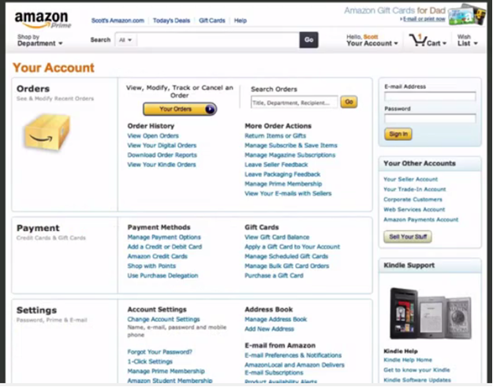
Amazon: left-aligned
Header for form (on top right) label on top.
Header less important when familiar with fields, can stick out less.
  *from Scott Klemmor

Slide 34
Color
Color –rely on other tools first.
After scale, and layout, use black/white/grayscale.
After you have a good greyscale in black and white – add color.

Slide 35
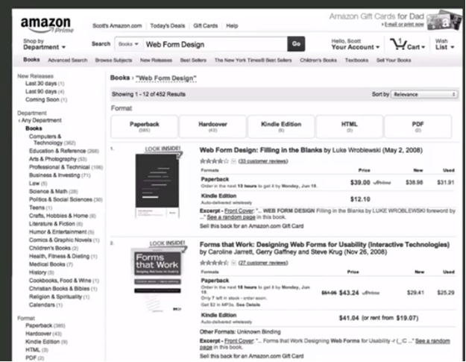
Amazon
  *from Scott Klemmor

Slide 36
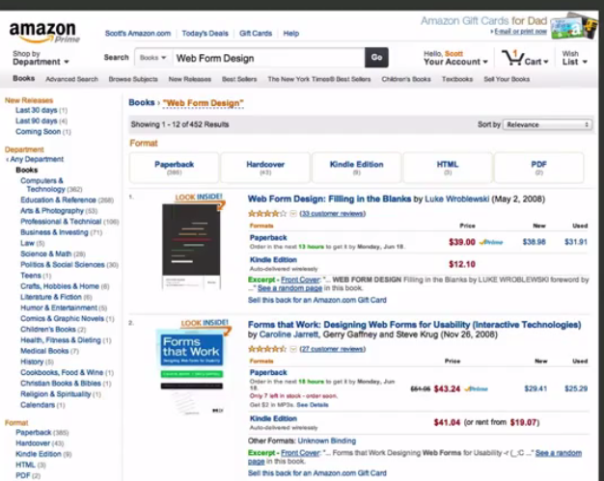
Amazon, cont.
It all worked, but if you use color better.
  *from Scott Klemmor

Slide 37
Color, cont.
Don’t overdo color. Fewer is more powerful.

Slide 38
Color is good…
Color can
  Soothe
  Add accents to an uninteresting display
  Facilitate subtle discriminations in complex displays
  Emphasize the logical organization of information
  Draw attention to warnings
  Evoke strong emotional reactions of joy, excitement, fear, or anger

Slide 39
Color can be bad…
Guidelines
  Use color conservatively
  Limit the number and amount of colors
  Color coding should support the task
  Consider the needs of color-deficient users
  Be consistent in color coding
  Be alert to common expectations about color codes
  Be alert to problems with color pairings

Slide 40
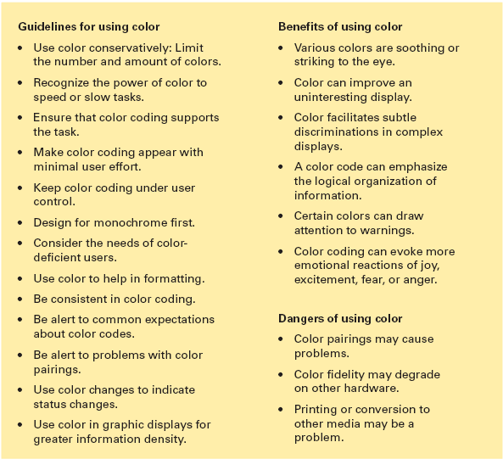
Color Guidelines
  Designing the User Interface: Strategies for Effective Human-Computer Interaction 5th edition by Ben Shneiderman and Catherine Plaisant.

Slide 41
Affordances
Affordances – perceived and actual properties of an object.
A chair affords (“is for”) support, therefore sitting.
Glass is for seeing through.
Wood is used for solidity, opacity, support, or carving.
Flat smooth surfaces are for writing on.
So wood is also for writing on.
  *Design of Everyday Things
Notes:
Design of Everyday Things, page 9.

Slide 42
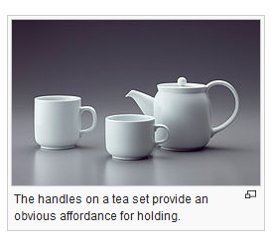
Affordance Example
*wikipedia
Notes:
From wikipedia

Slide 43
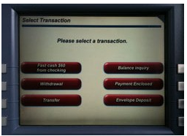
Perceived Affordance
Perceived affordance – action a user perceives as being possible based on how the object is being presented:
For example, if your design includes a “button” make that button look pushable.
ATM example - many users try to press these buttons, only to realize after a few attempts that the buttons are actually to the right and left of each label. In this case, objects give off an inaccurate perceived affordance.
Johnny Holland

Slide 44
Affordances, cont.
Affordances provide clues to the operations of things. Knobs are for turning. Slots are for insert things. Balls are for throwing or bouncing.
When affordances are taken advantage of, the user knows what to do just by looking. No picture, label, or instruction is required.
Complex things may require instruction, but simple things should not.
When simple things need pictures, labels, or instructions, the design has failed.
*Design of Everyday Things
Notes:
, page 9.

Slide 45

Digital affordances
Amazon’s “add to cart” button provides a cue to initiate a buying experience.

Slide 46
Intentionally bad website!
https://userinyerface.com/
What do you press?

Slide 47
Cultural Constraints, Cultural Conventions
Convention constrains creativity.
However, unless we follow the major conventions, we are doomed to fail.
You cannot successfully introduce:
  a non-qwerty keyboard today
  Scrollbars not on the right-hand side
  Or require double-clicking on web links.
For better or for worse, human culture changes slowly, if at all.
jnd.org

Slide 48
Cultural constraints and conventions, cont.
Cultural constraints and conventions are about what people believe and do.
The way to find out what people do is to go out and watch them.
Not in the laboratories, not in the usability testing rooms, but in their normal environment.
jnd.org

Slide 49
What Designers Should Do
Visibility – Any function that a user can do - make it visible.
Provide user with clear feedback so they know what’s happening.
Be consistent with existing standards and platform conventions.
Make them able to undo.
Provide a systematic way to discover all functionality.
  Example: a new website – rollover all menu bar should show you every option
Reliable – random things shouldn’t happen, what’s supposed to happen should.
  *from Scott Klemmor

Slide 50
Poll: Gui vs Command-Line Poll
Notes:
Poll Title: GUI or command-line: Which is better?
https://www.polleverywhere.com/multiple_choice_polls/2MvHxbTY2AB4DEH

Slide 51
GUI vs. Command-line
Which is better?
It depends
Based on the 6 principles, GUI is better – visibility, feedback, consistency, non-destructive, discoverability
  GUI – move file – drop and drag
  Command-line – need to know name of the command, minimal feedback, don’t know if worked, easy to make errors.
  Either can be reliable.
Command-line is better sometimes, when is that?
  Like programming, power when you can express things abstractly and work more efficiently.
  Example: move all files that match a certain criteria from one place to another.
  *from Scott Klemmor

Slide 52
Information
People want information quickly.
Watch users use the site:
    Do they know where to go or flail around?
    Look at their confidence before and after.
    Back Button - lots of use of the back button means there are issues with the navigation.
  *from Scott Klemmor

Slide 53

Tips
Generic icons rarely help, use specific icons.
Icons help when:
  Show what you expect
  When you know what something looks like but not what it’s called.
  Good redundant coding can help – picture and word example:
  (can mouseover volume icon)
  *from Scott Klemmor

Slide 54
More Tips
Improve website:
  Lengthen link – don’t use one short word
  Long titles (7/8 words)
  also helps accessibility – if using screen reader
Example:
  You can find the video here
  Or better yet:
  Here is a video on HCI Design.
  *from Scott Klemmor

Slide 55
Location
Does the location of a link matter?
YES!

Slide 56
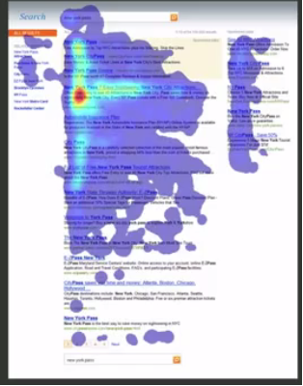
Eye Tracking Studies
Eye Tracking Studies show there are places on the screen where the users look most often:
  *from Scott Klemmor
Ed Cutrell – Microsoft Research.

Slide 57
Eye Trackers
Eye Tracker Video
Cristiano Ronaldo

Slide 58
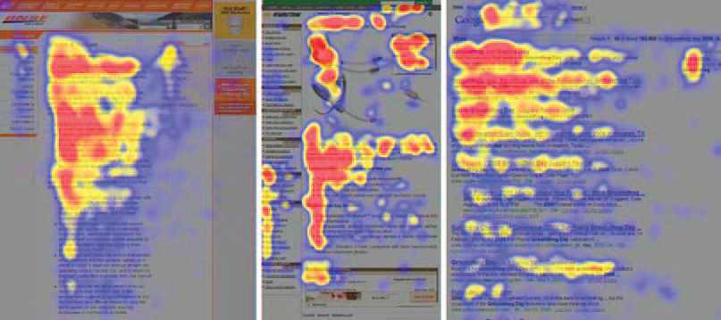
Eye tracking studies, cont.
The heatmaps from the eyetracking study. Red indicates the area where the user
looked most, yellow indicates fewer views, and blue indicates the fewest views.
Gray is used for areas that were not viewed. The image on the left is from an article
in the “About us” section of a corporate web site, the center image is a product
page on an e-commerce web site, and the image on the right is from a search
engine results page (Jakob Nielson).

Slide 59
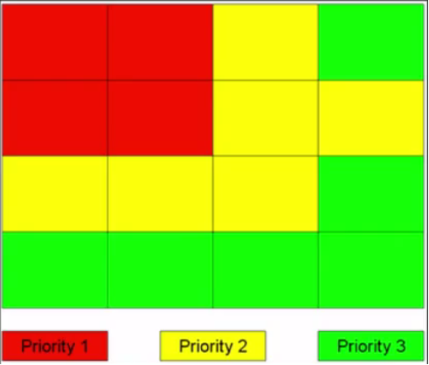
Where do people most often look?
Know where good stuff often is.
Poynter Institute: Where people mostly look in English language websites (left to right)
Priority:
Top Left
Secondary
Lowest priority.
Below and far right.
  *from Scott Klemmor

Slide 60
Poll: Where do people look most often on the screen?
Notes:
Poll Title: Where do people look most often on the screen?
https://www.polleverywhere.com/multiple_choice_polls/DoCyVR1vDHvZdEG

Slide 61
Scrolling
People are more likely to scroll if they think it’s worthwhile.
If the content above doesn’t look good, people won’t scroll down.
If the content on top is really good then people will scroll.
  *from Scott Klemmor

Slide 62
How do people read online?
Usability Expert Jakob Nielson studied how people read online.
The answer:
  They don’t
Web Browsing –people don’t stay on one site – they have many tabs open and switch between them.
Therefore:
  concise text
  Scannable: subheadings, bulleted lists, short paragraphs
  *from Scott Klemmor

Slide 63
HW Discussion

Slide 64
Activity: Fitts’s Law
Time it takes a user to point to an object using a device such as a mouse, trackpad or finger)
Large targets close by lowest interaction cost
Small targets far away have higher interaction cost

Slide 65
Interactive Exercise
Fitts Law Activity
Round 1: click white then color:
All balls the same size and equal distance to the white circle so should be around the same time to click each one
Round 2: vary distance, colored circles will be closer and further away from white
Blue was closer
Green middle
Red furthest
Round 3: vary size of ball
Blue is smallest
Green next smallest
Red biggest (bigger is easier to click)

Slide 66
Interactive Exercise, cont.
Fitts Law Activity
Round 4: varying sizes and distances
Blue closer and big
Green smaller and medium
Red bigger and further
Yellow further and smallest longest
Blue least – big and close - least
Yellow further and smallest – most
Other two around same small and closer, big and further
STOP BEFORE Round 5 different input devices

Slide 67


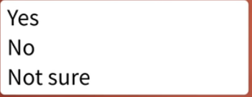
Fitts’s Law: Practical Applications, cont.
Important actions should be larger so easier to select.
Make buttons and elements big enough as users may have trouble with small ones!
Add padding or whitespace
Interactive Lists - Shorter is better. Ideally if possible.
Keep Interaction costs low
SUBSCRIBE

Slide 68

Fitts’s Law: Practical Applications, cont. (1)
Buttons to complete an action should be close to active elements.
Email: radler@Illinois.edu
Password: ****
If further away make it bigger to compensate.

Slide 69
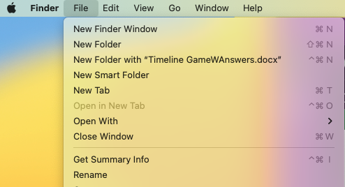
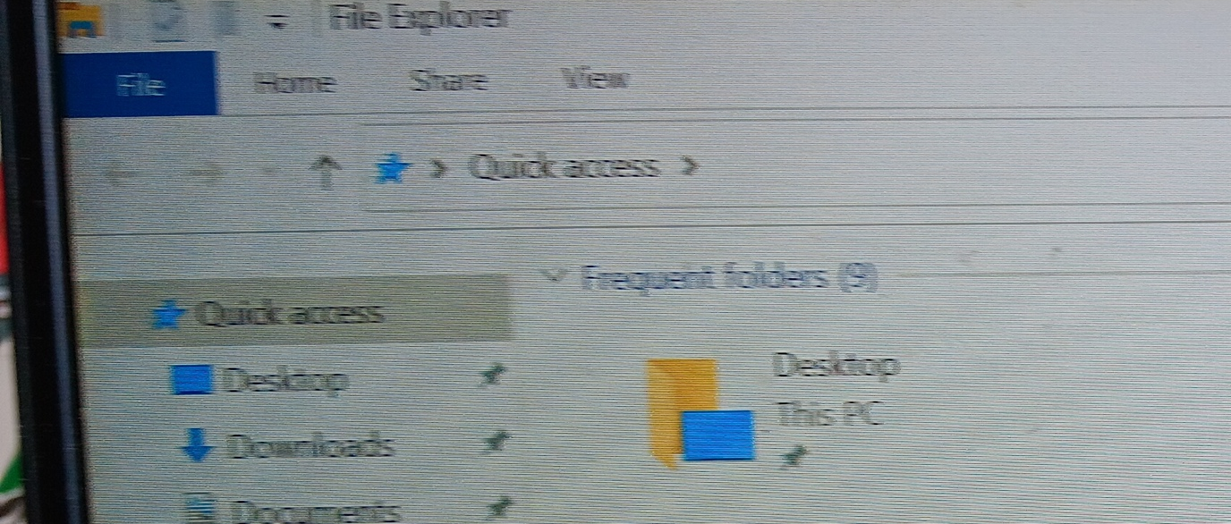
Fitts’s Law: Wow
An edge of the screen is usually faster to target than any other object, even one much closer.
  Top and bottom (never overshoot)
  Left and right
Pull down menus on the Macintosh are fasters than Windows menus!
  Move your mouse to the top so you can’t overshoot. Always get menubar.
  Windows you have to point carefully.
Lesson: something needs quick access put it on an edge.
Mac
Windows

Slide 70
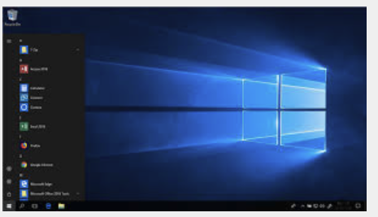
Fitts’s Law: Wow (1)
Corners even better – infinite height and width. Though operating systems don’t make use of those generally.
Windows– start menu bottom left of the screen for faster access

