Slide 1
Introduction to Human-Computer Interaction

Slide 2
Welcome!
Go over Syllabus.
Go over Webpage & Canvas
Email me with any questions!
Many Slides for this course from:
  Scott Klemmor hci-class.org
  Designing the User Interface: Strategies for Effective Human-Computer Interaction 5th edition by Ben Shneiderman and Catherine Plaisant.
  Human-Computer Interaction 3rd edition by Alan Dix, Janet Finlay, Gregory D. Abowd, Russel Beale.
  Design of Everyday Things by Don Norman
  Various other articles and my own thoughts

Slide 3
Let’s Do Some Polls!
Reviewing what we said:
  Does this course have a group project?
Getting to know you:
  What is one word to describe yourself?
  What is your major?

Slide 4
Introduction
Human-Computer Interaction (HCI) is an interdisciplinary field connecting many disciplines such as computer science, psychology, and many other fields with the goal of making computing systems that are both useful and usable.

Slide 5
Designing Objects
“’You would need an engineering degree from MIT to work this,’ someone once told me, shaking his head in puzzlement over his brand new digital watch. Well, I have an engineering degree from MIT. … Give me a few hours and I can figure out the watch. But why should it take hours? I have talked with many people who can't use all the features of their washing machines or cameras, who can't figure out how to work a sewing machine or a video cassette recorder, who habitually turn on the wrong stove burner.”
-Don Norman, Design of Everyday Things

Slide 6
Measuring Cup
Users were asked :
How can you improve a measuring cup?
  handle gets hot
  sometimes slippery
No one complained about measuring, but they watched people constantly add more in, over and over, until get the right amount. Stutter measuring.
  Scott Klemmor hci-class.org

Slide 7
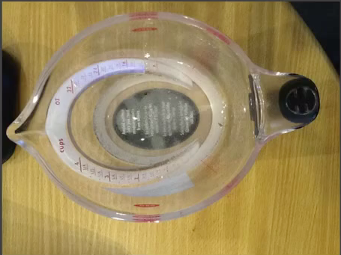
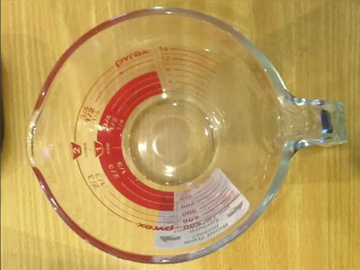
Improved Measuring Cups
Designed so you can read measurements from the top.

Slide 8
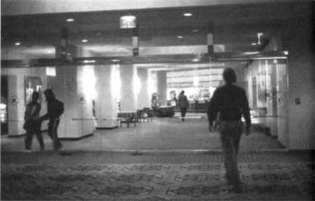
Doors
“But I shouldn't have trouble with doors and switches, water faucets and stoves. … I push doors that are meant to be pulled, pull doors that should be pushed, and walk into doors that should be slid …The answers should be given by the design, without any need for words or symbols, certainly without any need for trial and error.”
-Don Norman, Design of Everyday Things
Row of Swinging Glass Doors

Slide 9
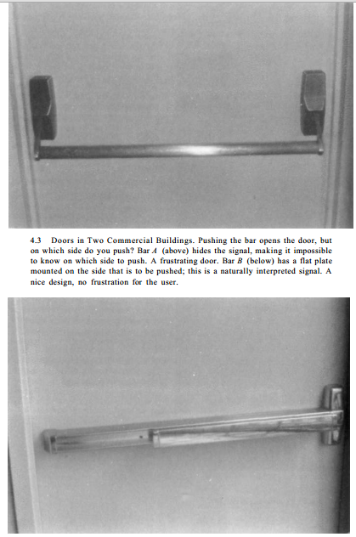
Bad and Good Doors
Bad Design – which side do you push? (top)
Good design – no frustration for the user (bottom)
*Design of Everyday Things
Notes:
, page 90

Slide 10
Doors!
It’s not you. Bad doors are everywhere.
Bad Doors
Notes:
Reddit featuring don norman - Don Norman

Slide 11
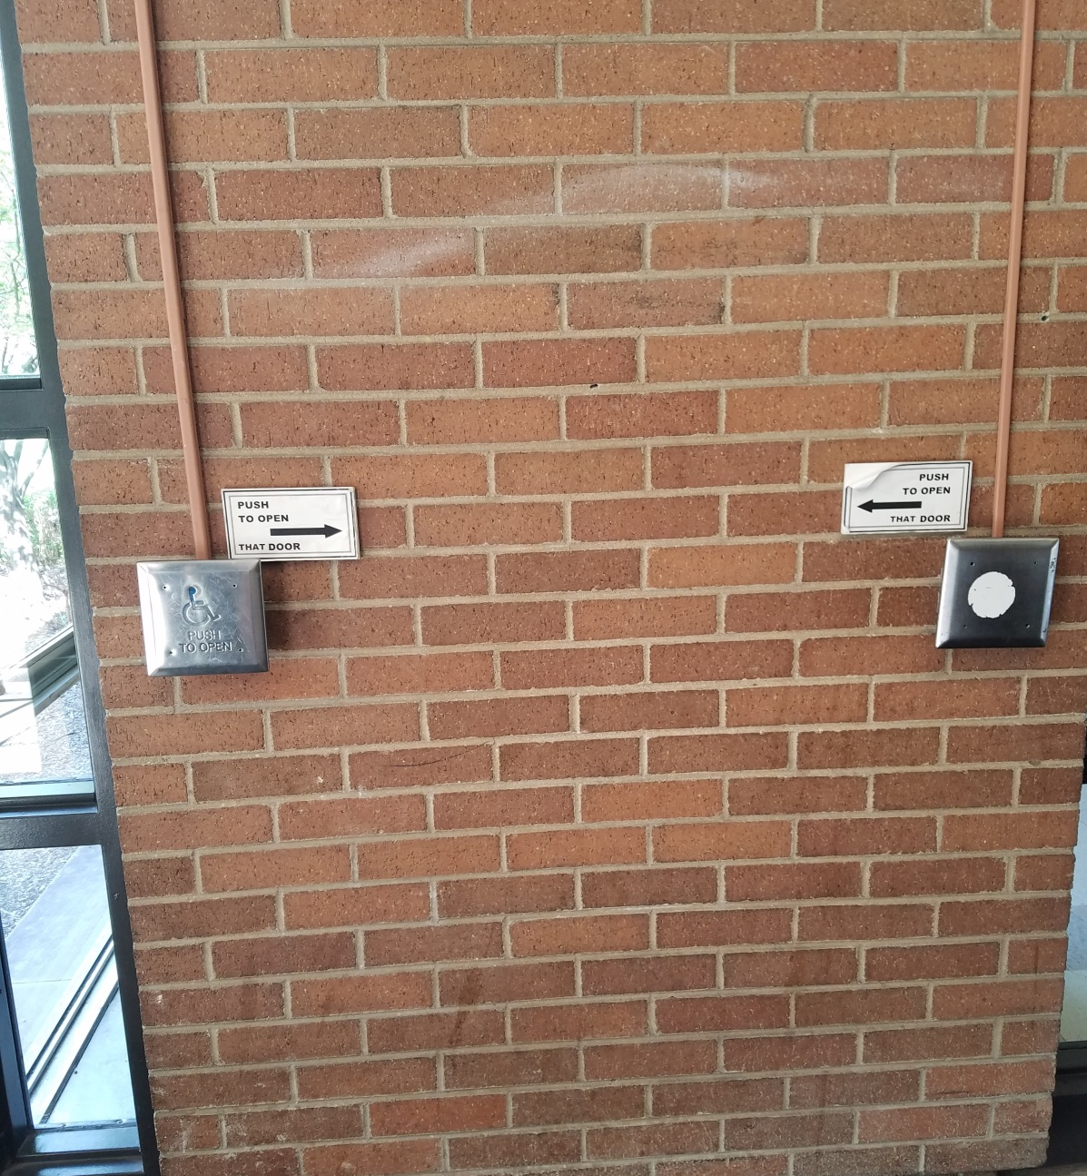
What?

Slide 12
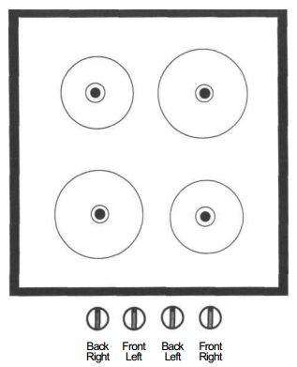
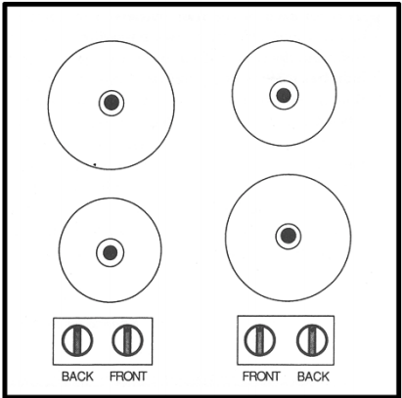
Stove
Bad arrangement of burners on stove:
Arbitrary
Paired
*Design of Everyday Things

Slide 13
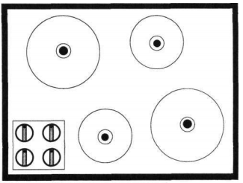
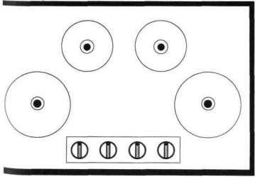
Stove, cont.
Better arrangement of burners on stove – No ambiguity.
*Design of Everyday Things
Notes:
Design of Everyday Things, page 77

Slide 14
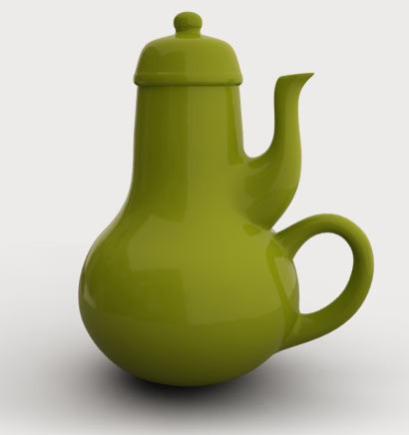
Poor Design
People blame themselves for their “stupidity” or “clumsiness” when making mistakes, especially if it is a simple task. People think they are mechanically incompetent.
Most accidents are attributed to human error.
However, many cases it is due to poor design.
It is not a user’s fault, but the designers!
Notes:
Artist – Carelman’s Coffeeepot for Masochists

Slide 15
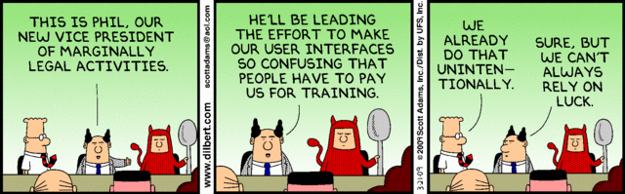
Lessons For the User
‘It is not your fault’ - When people have trouble with something it is not their fault, but the fault of the designer.
Try not to only criticize – think of a solution!
Observe!

Slide 16
Errors
Designer beware:
  Assume all possible errors will occur
  Design so as to minimize the chance of the error in the first place or its effects once it gets made.
  Errors should be easy to detect; they should have minimal consequences and be reversible!

Slide 17
Accessibility
Users with physical challenges
  Designers must plan early to accommodate users with disabilities
Older Adult Users
  Including older adults is fairly easy
    Designers should allow for variability within their applications via settings for sound, color, brightness, font sizes, etc. with less distracting animation.

Slide 18
Determine user’s skill levels
“Know thy user”
Age, gender, physical and cognitive abilities, education, cultural or ethnic background, training, motivation, goals and personality
Design goals based on skill level
  Novice or first-time users
  Knowledgeable intermittent users
  Expert frequent users

Slide 19
HCI Professionals
Often HCI Professionals are called in too late.
  A system has been designed and built and is now unusable, so they ask how do we do it right.
  Or companies think of it as testing – checking whether people can use it and fix problems rather than make sure they can from the beginning.
In the best companies, usability is designed in from the start.

Slide 20
End of Semester Goal:
“Now you are on your own. If you are a designer, help fight the battle for usability. If you are a user, then join your voice with those who cry for usable products. Write to manufacturers. Boycott unusable designs. Support good designs by purchasing them, even if it means going out of your way, even if it means spending a bit more. And voice your concerns to the stores that carry the products; manufacturers listen to their customers.
When you visit museums of science and technology, ask questions if you have trouble understanding. Provide feedback about the exhibits and whether they work well or poorly. Encourage museums to move toward better usability and understandability.
And enjoy yourself. Walk around the world examining the details of design. Take pride in the little things that help; think kindly of the person who so thoughtfully put them in. Realize that even details matter, that the designer may have had to fight to include something helpful. Give mental prizes to those who practice good design: send flowers. Jeer those who don't: send weeds.”
-Design of Everyday Things, Page 216-217
Notes:
DOIT: 2

Slide 21
Other Don Norman Talks
Thoughtful Design: Thoughtful Design Video by Don Norman
Ted Talk: Beauty vs. Useful Designs
Ted Talk on Beauty (by Don Norman)
Notes:
Show first 5 minutes

