Slide 1
Designing Experiments

Slide 2
Acknowledgements
Many Slides for this course from:
  Scott Klemmor hci-class.org
  Designing the User Interface: Strategies for Effective Human-Computer Interaction 5th edition by Ben Shneiderman and Catherine Plaisant.
  Human-Computer Interaction 3rd edition by Alan Dix, Janet Finlay, Gregory D. Abowd, Russel Beale.
  Design of Everyday Things by Don Norman
  Various other articles and my own thoughts

Slide 3
Do you like my interface?
Do you like my interface?
Not very specific.
People will say,
  “Yeah, sure”
Can Improve it by:
  How much do you like this interface on a 1-5 scale.
But still - “Compared to what?”
  Scott Klemmor

Slide 4
Do you like my interface?
Is interface x better than y?”
That’s better than “Is Interface x good?”
Sometimes:
  it depends – May be better for some things but worse for other things.
  Example: Tablet – good for reading/web browsing/pictures. Not as good for typing a novel.
  Scott Klemmor

Slide 5
Controlled Laboratory Experiment
Controlled Experiment:
  Powerful method of evaluating a design.
  Users are taken out of their normal work environment to take part in controlled tests often in a special laboratory.
  Useful for evaluation of specific interface features.
  Taking 2 or more conditions and comparing them. Learning which option is the more effective one for the user experience you seek.

Slide 6
Controlled Experiment
Have you ever participated in an experiment?

Slide 7
What is a Controlled Experiment
A controlled experiment usually compares the results from an experimental sample against a control group.
The control sample is practically identical to the experimental sample with one aspect that is being tested.

Slide 8
Hypothesis Testing
Hypothesis
  a predication of the outcome of an experiment.
The aim of the experiment is the show that this prediction is correct.
How to “prove” a Hypothesis
  Often you can disprove the null Hypothesis
null hypothesis states that there is no difference in the dependent variable between the levels of the independent variable.

Slide 9
Controlled Experiments
A controlled experiment is powerful because it uses empirical evidence to support a hypothesis.
Process of the Experiment:
  Hypothesis to test, which can be determined by measuring some attribute of user behavior.
  A number of experimental conditions which differ only in the values of certain controlled variables. Therefore, any changes in the behavioral measures are attributed to the different conditions.

Slide 10
Independent and Dependent Variables
Independent Variable:
Conditions - what you are manipulating. Independent of what users does. Examples:
    Time of class, interface style, …
  Dependent Variable:
  What you are measuring. Their value is dependent on the changes made to the independent variable. Examples:
  Task completion time – how long does it take the user to complete a task.
  Accuracy – how many mistakes did people make (how many were fatal errors or were they able to recover from them)
  Recall - how much does the user remember after.
  Emotional – was the user confident, stressed, satisfied would they recommend it to a friend.

Slide 11
Example:
Hypothesis: Having vitamin C will increase your lifespan.
Independent Variable:
  Vitamin C or placebo
Dependent Variable:
  Lifespan

Slide 12
Experiments
Independent – you manipulate
Dependent - you measure
How reliable is the experiment – if you ran it again would you get the same results?
  Study enough people so it’s not by chance.
Generalizability – does it only apply to 18 year- olds in classrooms or to other people as well.

Slide 13
Poll: Jane wants to determine the best place she can grow plants in her apartment. She puts one plant on her balcony, one by the kitchen window, and one in the living room. Which is the INDEPENDENT VARIABLE?
Notes:
Poll Title: Jane wants to determine the best place she can grow plant. She puts one on her balcony and one by the kitchen window. Which is the DEPENDENT VARIABLE?
https://www.polleverywhere.com/multiple_choice_polls/GfGhAepcKW9d9tV

Slide 14
Poll: Jack wanted to see how high an ice cube would float in different temperatures of water. Which is the DEPENDENT variable?
Notes:
Poll Title:
https://www.polleverywhere.com/multiple_choice_polls/Q0z2UVDeN4oW8ZM

Slide 15
Another Example – You tell Me
Comparing robotic vacuum cleaner and regular vacuum cleaner.
Independent variable:
Dependent variables:
Hypothesis:

Slide 16
Variables
Independent Variable: vacuum type
Dependent Variable: faster and cleaner
Between subject design. Half participants in robot vacuum condition and half use the regular vacuum.
Sample Size: Let’s say robotic IS faster and cleaner, but if you only have 6 people, maybe those 3 people were better cleaners…
Notes:
Dependent variables: cleaner, faster, fewer errors, …

Slide 17
Participants
Participants should be chosen to match the expected user population as closely as possible.
In a controlled experiment, the sample size must be large enough to be considered representative of the population.

Slide 18
Running Experiments
When running experiments, think about:
  Choosing Participants
  Independent Variable/Dependent Variables
  Hypothesis
  Within-subject/Between-subject design

Slide 19
Experimental Design
Choose the hypothesis, clarify the independent and dependent variables. How many participants can you get? Are they representative of your user group?
Which experiment method will you use:
  Between-subject
  Within-subject

Slide 20
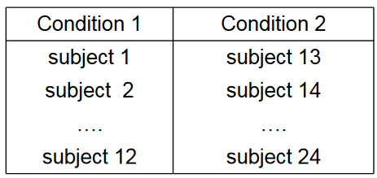
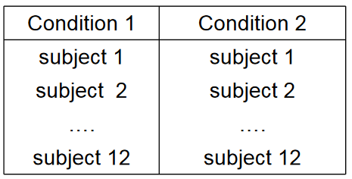
Experimental Method
  Between-subjects:
  (or randomized design) – each participant is assigned to a different condition (randomly)
  2. Within-subjects
  –(or repeated measures) – Each participant performs both conditions.

Slide 21
Within- and Between-Subject Design
Within-subjects – everyone tries all options – more work out of each participant.
Between-subject – requires more people. Benefit uncorrupted and most common.
Pros and Cons to each method.

Slide 22
Within-Subjects
Advantages:
  Fewer subjects needed, less expensive
  Less chance of effects from variation between participants.
Disadvantages:
  Learning effects
  Fatigue
Learning effects can be lessened if the order in which the conditions are tackled is varied between users.
For example group A does first condition followed by second and group B does second condition followed by first.
Other solutions: more practice before testing

Slide 23
Between-Subjects
Advantages:
Controlled – no learning effect.
Disadvantage:
Need more participants. Variations between the groups can negate the results.
Should all participants use every alternatives? (within design vs. between design)
  Trade-offs to different approaches.

Slide 24
Controlled Experiments Pros/Cons
Advantages:
  Participant operates in an interruption-free environment.
  We can manipulate the context in order to uncover problems.
  See actual behavior instead of what user reported.
Disadvantages:
  Lack of context – not the same as the work environment. Problem: Not realistic in your lab, not necessarily how they would use it in real life.

Slide 25
Other Styles of Evaluation: Field Study
Field Study:
Designer observes them in action.
Advantages:
  The context is retained. The user is in his natural environment.
Disadvantages:
  Participant may be influenced knowing there is an analyst or recording equipment. (Try to be slightly removed.)
  Noise, interruptions

Slide 26
Field Study vs. Controlled Laboratory Experiment
Field Study vs. Controlled Laboratory Experiment
Field study may be preferable to laboratory studies.
Weigh the cost of disrupting the actual work situation with the costs of taking a couple of participants away from the jobs into the laboratory.

Slide 27
Other Styles of Evaluation: Survey
Survey
Surveys – ask questions to measure something - tend to be classified as quantitative research
Advantages
Quickly get a large number of responses, easy to compare and tally results.
Disadvantages:
What they say is not necessarily what they do.
  Ask someone how much they plan on exercising – different than what they do. Still valuable not great.

Slide 28
Other Styles of Evaluation: Focus Group
Focus Group
  Small group discussing things.
Has anyone participated in one?
Advantages/Disadvantages:
  Can get people to say things, but people may say what they don’t really mean or do.

Slide 29
Experiment To-Dos
Make Clear Goals
  Purpose – What is the purpose of your system?
  Hypothesis – What do you predict?
  Participants- Who will you recruit? How many people?
  – Dependent Variables - Measures (task completion time, etc.)
  Independent Variables – Different conditions with randomization - each participant should have equal chance of ending in either condition.
  Why is randomization important?

Slide 30
Experimental Details
Training – May give them some training first.
Pilot! Have people go through it before the users! They can find the obvious usability bugs that you don’t want to burden users.
Use one with a colleague who knows interface then with a real user. Pilots help you discover mistakes first.

Slide 31
Designers
Designer – used to create one thing. Now a designer creates several things and compares and experiments.
Important because easy to be too sure of yourself. Trying things out is better.

Slide 32
Running Experiments Online
Web makes it easy to run experiments:
  May call it:
  A/B Test
  Controlled Experiment
A – current live version (control)
B – something you are trying

Slide 33
Running Online Experiments, cont.
Collect click-throughs or other things you can measure to decide which one is better.
Examples:
  You can have 2 versions of a website, one with 2 columns and one with 1. You can monitor the number of sales on each site. Web can let you have real feedback quickly.
  Can send two different emails to different people. Can see how many clicked to web, how many forwarded, etc.

Slide 34
Example with click-through rates
Which would be better for someone’s website?
I’m on Twitter
Follow me on twitter
You should follow me on twitter
You should follow me on twitter here
  Scott Klemmor

Slide 35
Example with click-through rates, cont.
I’m on Twitter – 4.70%
Follow me on twitter – 7.31%
You should follow me on twitter – 10.09%
You should follow me on twitter here… 12.81%
Follow me – imperative – better
clearer is better and causes more users to click through.
  Scott Klemmor

Slide 36
Principles of running experiments:
50/50 – equal number of people in each condition.
Random Assignment:
  Run both at same time in parallel. In case one day a week has different problems.

Slide 37
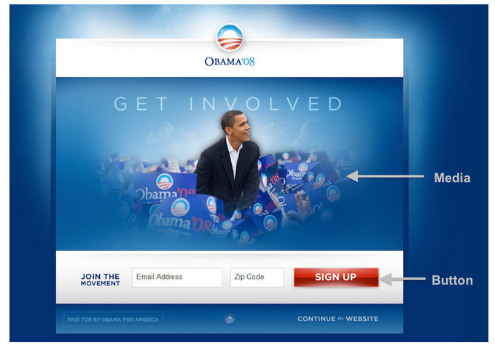
Another Example - Obama 2008

Slide 38
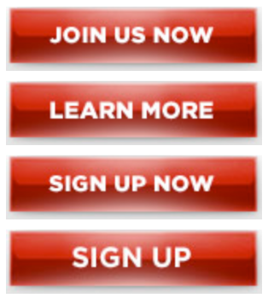
Obama ’08, cont.
Obama campaign – Wanted to turn site visitors into subscribers:
Email can help convert people into donors!
4 versions of buttons & 6 different media (3 images and 3 videos)
Tested all combinations
Sign-up rate: # who signed up / # saw that particular variation
The Experiment

Slide 39
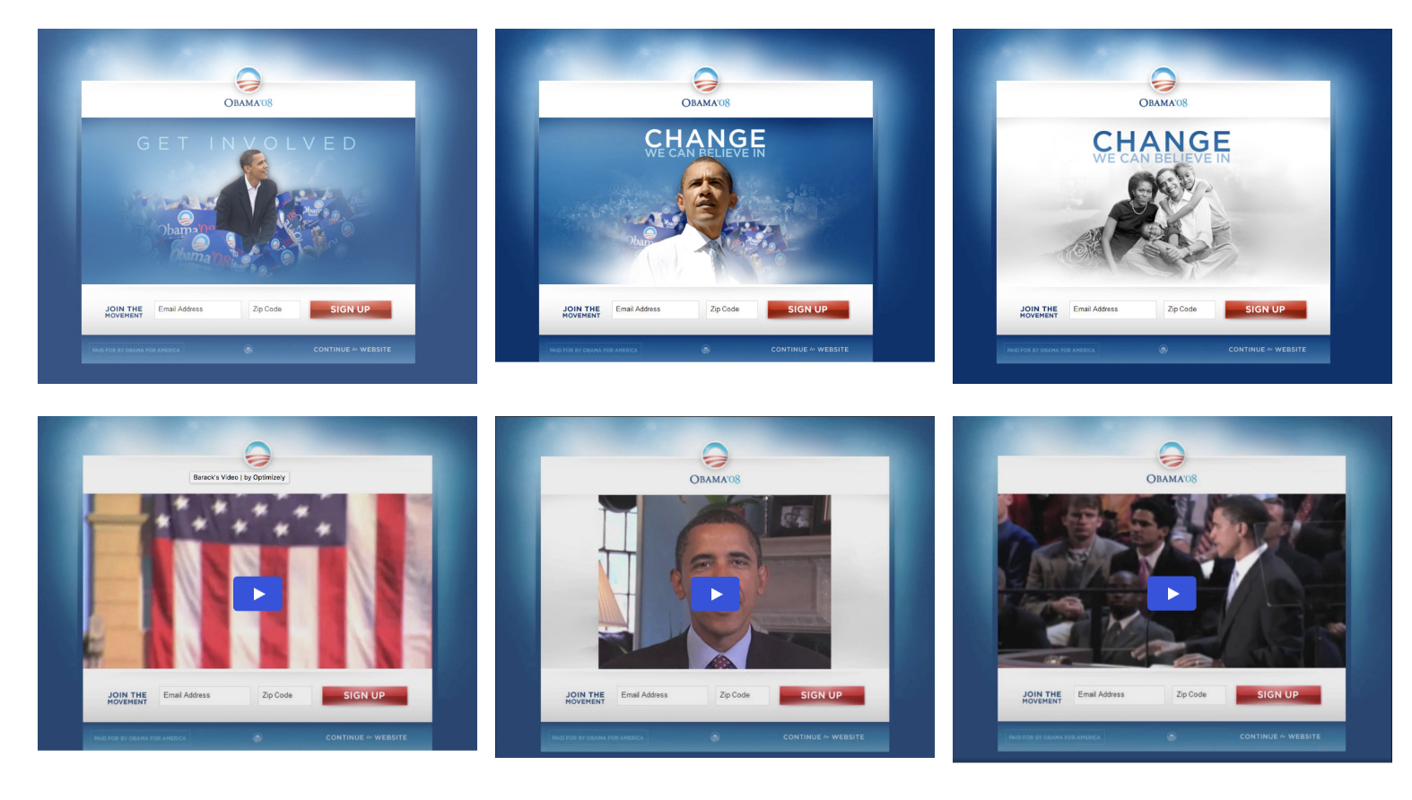
Video/Image combinations

Slide 40
Video Options
Barak’s video: https://videopress.com/v/cBvFxm8E
Springfield Video: https://videopress.com/v/079hUYvM
Sam’s Video:
https://videopress.com/v/sNzmO0TR
Notes:
https://www.youtube.com/watch?v=71bH8z6iqSc

Slide 41
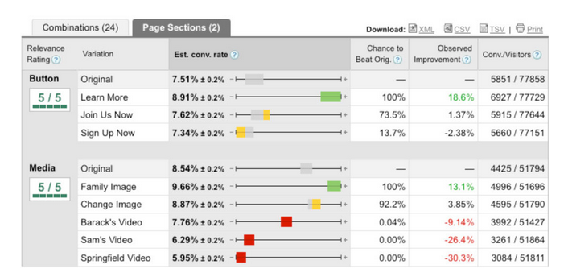
Results – Obama ‘08
Before the experiment, the campaign staff favored “Sam’s Video” (the last one shown on the previous slide website).
Using it would have been a huge mistake since it turns out that all of the videos did worse than all of the images.

Slide 42
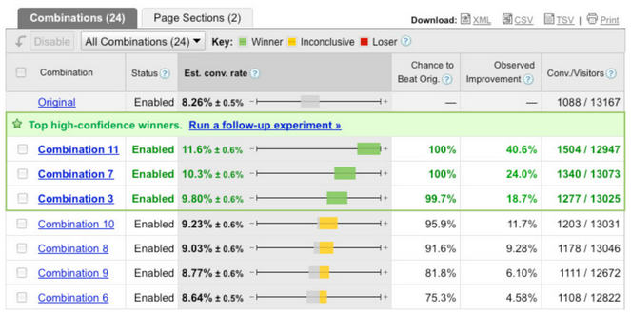
Winning Combination
The winning variation had a sign-up rate of 11.6%. The original page had a rate of 8.26%. That’s an improvement of 40.6%.

Slide 43
Results – Obama ’08 cont.
10 Million signed up. It would have been 7,120,000.
That’s a difference of 2,880,000 they can email.
10% of those emailed volunteer, that’s a difference of 288,000 volunteers.
On average each email donates $21. 21 X 2,880,000 is a little over 60,000,000.
This is a difference of an additional $60 million in donations.

Slide 44
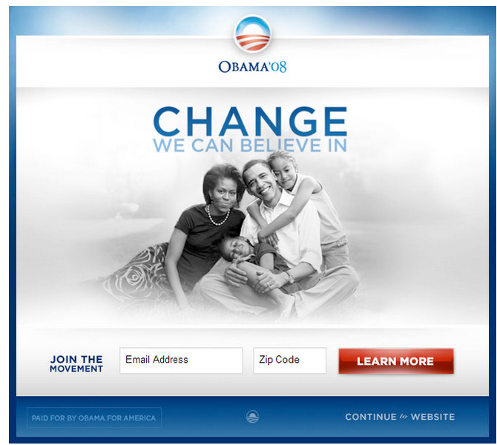
The Winner

Slide 45
Class Activity: Plan an Experiment
Groups of 4-5:
  What is your hypothesis
  Who are your participants?
  What is your independent variable?
  What are your dependent variables?
  Is there a control group?
  Between subject or within-subject design?
  Describe the experiment
Topic Examples:
  Which flavor M&M is better?
  Does music help me study better?
  Does Caffeine really work?
You will present to the class

